Slide 1
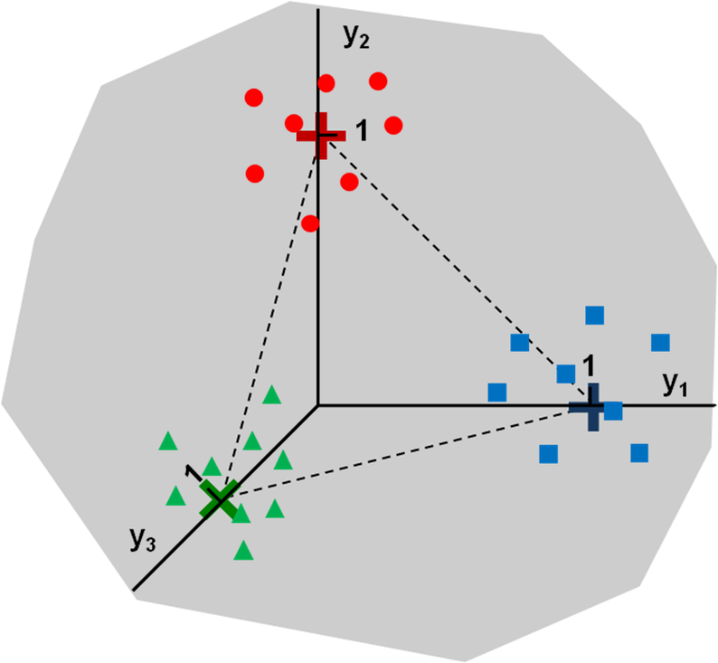

Multi-class PLS-DA: soft and hard approaches
Alexey Pomerantsev, Oxana Rodionova
Semenov
Institute
of Chemical
Physics

Slide 2
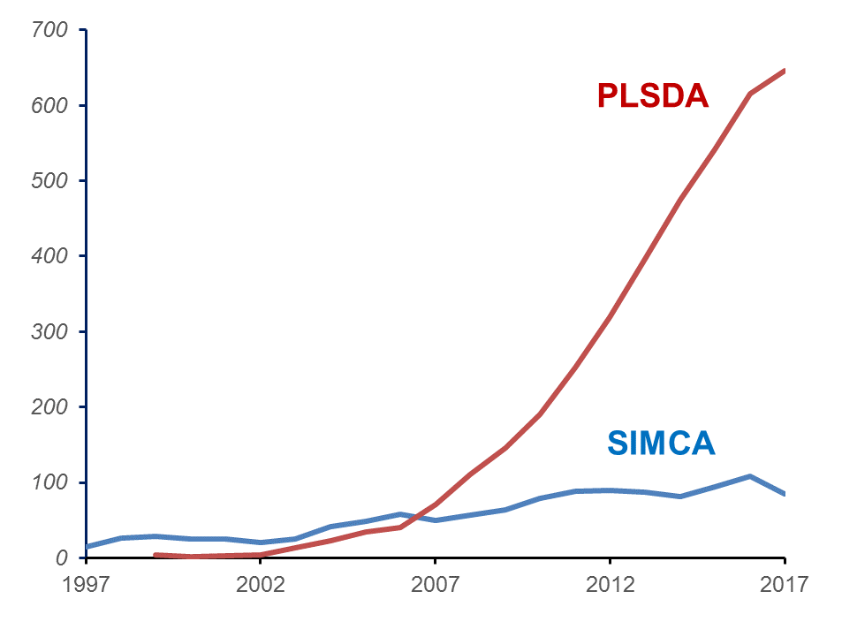
Papers by Scopus

Slide 3
Motivation: 1 of 4
PLS-DA is an enormously popular method that, however, has few theoretical papers.
1. L. Stahle, S. Wold, Partial Least Squares Analysis with Cross-Validation for the Two-Class Problem: A Monte Carlo Study, J. Chemom., 1, 185-196 (1987).
2. M. Barker, W. S. Rayens, Partial least squares for discrimination. J. Chemom., 17: 166-173 (2003)
3. U. G. Indahl, H. Martens, T. Næs, From dummy regression to prior probabilities in PLS-DA. J. Chemom. 21:529–536 (2007)

Slide 4
Motivation: 2 of 4
Most papers are concern with a binary PLS-DA. In attempts to avoid the actual multi-class discrimination, researchers invent very complex schemes that split a multi-class task into a set of binary problems .
Fig. 1. Calculation of the reliability of classification for a classification
problem with C= 3 classes.
N. F. Perez, J. Ferre, R. Boque, Multi-class classification with probabilistic discriminant partial least squares (p-DPLS), Anal. Chim. Acta, 664: 27–33 (2010)

Slide 5
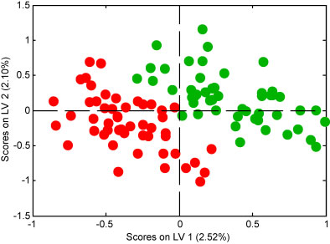
Motivation: 3 of 4
The application of the PLS scores for classification can lead to incorrect results and wrong interpretations.
Figure 4. Score plot for a PLSDA model of random data. Excellent—but meaningless—class separation is obtained
K. Kjeldahl, R. Bro, Some common misunderstandings in chemometrics, J. Chemom.; 24: 558–564 (2010)

Slide 6
Motivation: 4 of 4
PLS-DA is an inappropriate method of authentication. In fact, PLS-DA has a serious shortcoming being a hard classification tool. Is it possible to soften it?
Fig. 2. Application of PLS-DA for authentication.
O.Ye. Rodionova, A.V. Titova, A.L. Pomerantsev, Discriminant analysis is an inappropriate method of authentication, Trends Anal. Chem., 78 (4), 17-22 (2016)

Slide 7
Basics
J variables (fingerprints)
K classes
x₁₁ | x₁₂ | … |  |  | … | x_{1k}
… | … | … |  |  | … | …
x_{i1} | X_{i2} | … |  |  | … | x_{ik}
x_{i+1,1} | x_{i+1,2} | … |  |  | … | x_{1+1,k}
… | … |  |  |  | ... | …
x_{n1} | x_{n2} | ... |  |  | ... | X_{nk}
… | … | … |  |  | … | …
x_{i+1,1} | x_{i+1,2} | … |  |  | … | x_{1+1,k}
x_{n1} | x_{n2} | ... |  |  | ... | x_{nk}
X
Y
CLASS 1
e₁
I samples
CLASS 2
PLS2
e₂
...
CLASS K
e_{K}
e₂=(0,1,0,..., 0)
e₁=(1,0,0,..., 0)
e₃=(0,0,1,..., 0)

Slide 8
PLS2 Technical Details
X
Y
1
3
X_{s}
Y_{s}
2

Slide 9
Naïve decision
Y
1.01 | 0.02 | … | -0.05
… | … | … | …
0.98 | -0.05 | … | 0
0.02 | 1.02 | … | 0.02
… | … | … | …
-0.03 | 0.95 | … | 0.06
… | … | … | …
0.04 | -0.02 | … | 1.05
… | … | … | …
-0.02 | 0.08 | ... | 1.1
1 | 0 | … | 0
… | … | … | …
1 | 0 | … | 0
0 | 1 | … | 0
… | … | … | …
0 | 1 | … | 0
… | … | … | …
0 | 0 | … | 1
… | … | … | …
0 | 0 | ... | 1
CLASS 1
CLASS 2
CLASS K

Slide 10

Key property of
Y
1 | 0 | … | 0
… | … | … | …
1 | 0 | … | 0
0 | 1 | … | 0
… | … | … | …
0 | 1 | … | 0
… | … | … | …
0 | 0 | … | 1
… | … | … | …
0 | 0 | ... | 1
Σ=1
…
Σ=1
Σ=1
…
Σ=1
…
Σ=1
…
Σ=1
1.01 | 0.02 | … | -0.05
… | … | … | …
0.98 | -0.05 | … | 0
0.02 | 1.02 | … | 0.02
… | … | … | …
-0.03 | 0.95 | … | 0.06
… | … | … | …
0.04 | -0.02 | … | 1.05
… | … | … | …
-0.02 | 0.08 | ... | 1.1
Σ=1
…
Σ=1
Σ=1
…
Σ=1
…
Σ=1
…
Σ=1

Slide 11
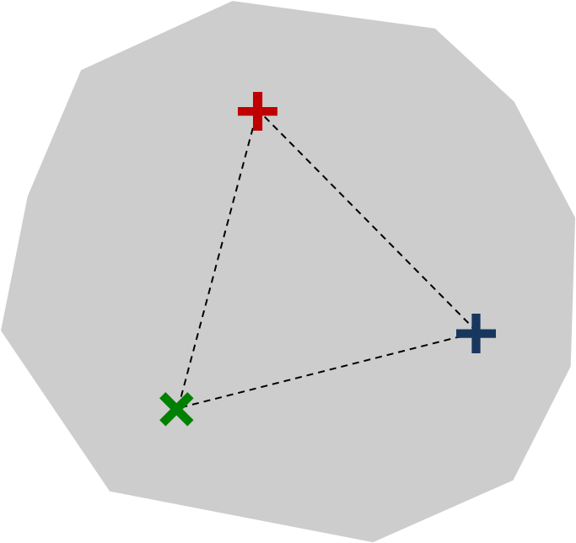
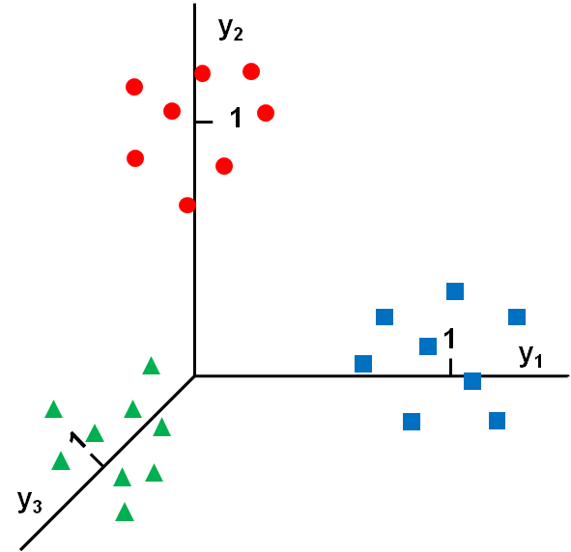
Geometry of
All Ŷ values are located on the hyperplane, which passes through the basic vectors:
e₁=(1, 0,...,0)^{t}
e₂=(0, 1,...,0)^{t}
.....
e_{K}=(0, 0,...,1)^{t}

Slide 12
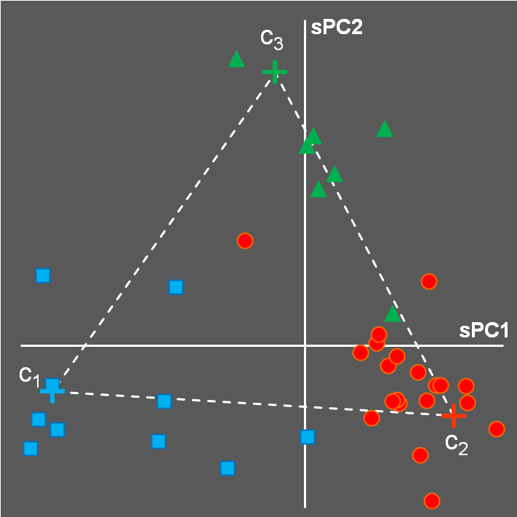
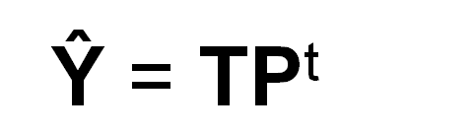
Superscores: PCA on
Class centers
e_{l}
c_{k}
0
...
1
...
0
c_{l,1}
...
...
c_{l,K-1}
PCA
Known centers of classes: c_{k}
Generic Mahalanobis metrics t^{t}Λ⁻¹t
Orthogonality Λ=T^{t}T

Slide 13




PLS-DA route
PLS-DA is not a classifier. It serves as a feature extractor from high-dimensional X space into low-dimensional Y space.
Similar to PCA.

Slide 14

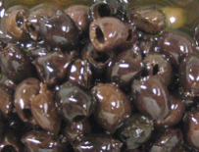

Datasets
Name | Classes | Variables | Samples
Juices | 3 | Concentrations 15 | 20+7+11=38
 | Fidelis, M., et al., Authentication of juices from antioxidant and chemical perspectives: A feasibility quality control study using chemometrics, Food Control, 73 ,796-805 (2017)
Olives | 3 | NIR spectra 1250 | 111+72+50=233
 | Oliveri P. et all, Partial least squares density modeling (PLS-DM) – A new class-modeling strategy applied to the authentication of olives in brine by near-infrared spectroscopy, Anal. Chim. Acta. 851, 30–36 (2014)
Drugs | 7 | NIR spectra 890 | 30+ 50+70+50+30+50+100=380
 | Rodionova O.Ye. et al, Quantitative risk assessment in classification of drugs with identical API content, J. Pharm. Biomed. Anal. 98, 186-192 (2014)

Slide 15
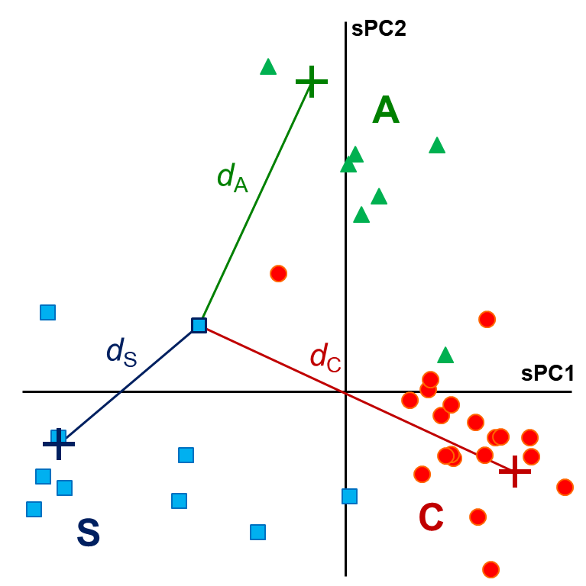
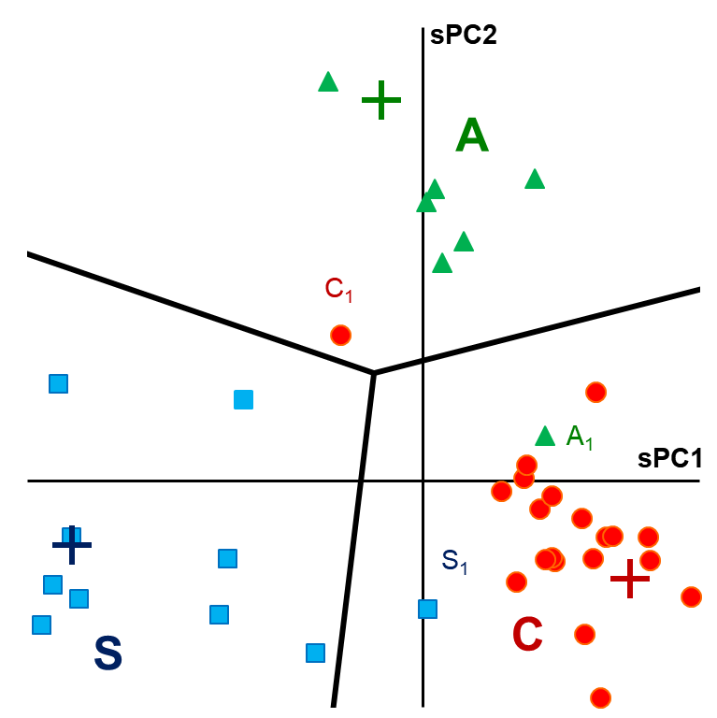
Hard PLS-DA: Juices
LDA
Λ=T^{t}T
d_{ik} = (t_{i} – c_{k})^{t} Λ^{–1}(t_{i} – c_{k})
min (d_{ik} )
All hyperplanes intersect at a one point.

Slide 16
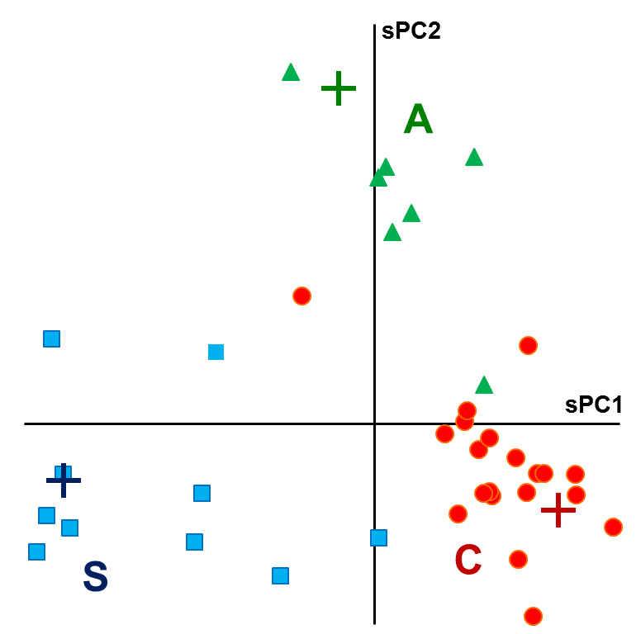
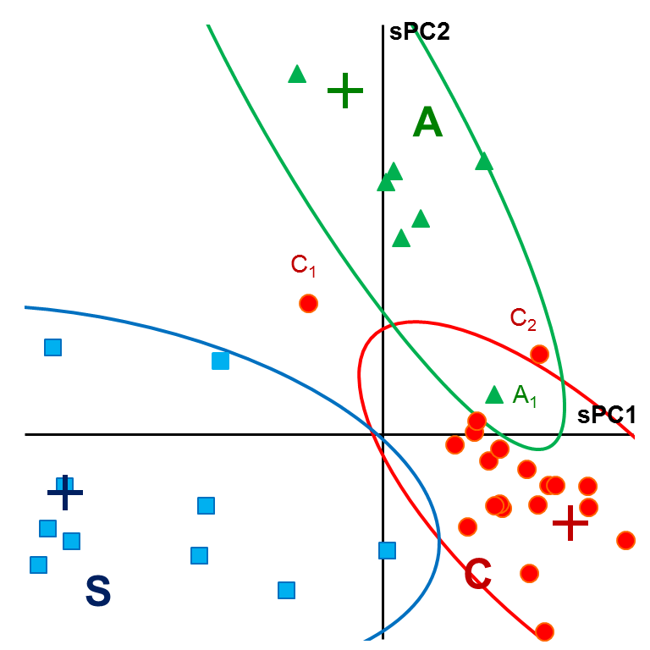
Soft PLS-DA: Juices
QDA
d_{ik}<χ^{–2}(1–α, K–1)
Soft classification:
a sample can be attributed to several classes, or not classified

Slide 17
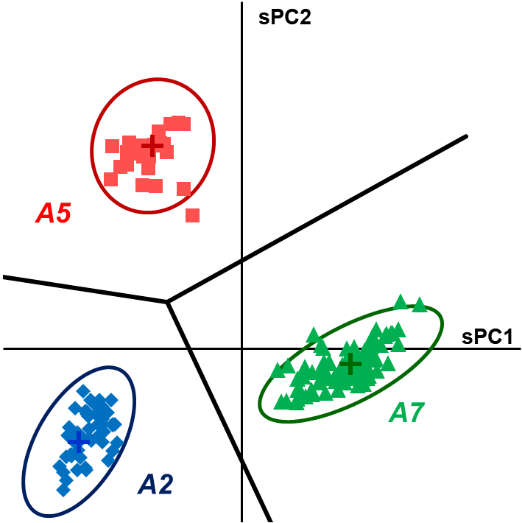
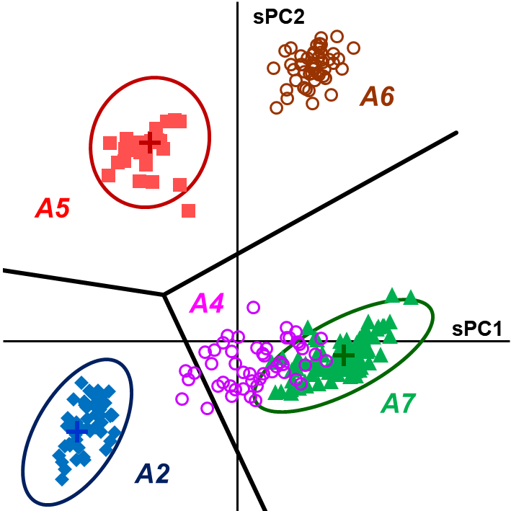
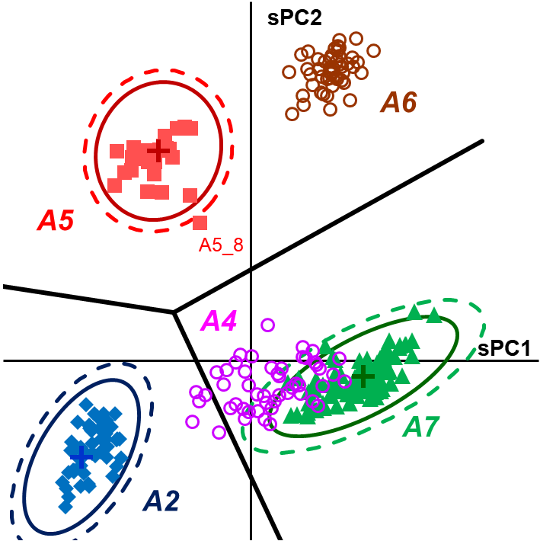


Outliers and aliens: Drugs
A2, A5, A7
training classes
A4, A6
new classes
outlier

Slide 18


Confusion matrix: Juices
Hard
Soft

Slide 19
Figures of Merit: True Positive
 |  | C | A | S
True Positive | TP | 18 | 7 | 11
False Positive | FP
Class Sensitivity | CSNS
Class Specificity | CSPS
Class Efficiency | CEFF

Slide 20
Figures of Merit: False Positive
 |  | C | A | S
True Positive | TP | 18 | 7 | 11
False Positive | FP | 1 | 1 | 0
Class Sensitivity | CSNS
Class Specificity | CSPS
Class Efficiency | CEFF

Slide 21
Figures of Merit: Class Sensitivity
 |  | C | A | S
True Positive | TP | 18 | 7 | 11
False Positive | FP | 1 | 1 | 0
Class Sensitivity | CSNS | 90% | 100% | 100%
Class Specificity | CSPS
Class Efficiency | CEFF

Slide 22
Figures of Merit: Class Specificity
 |  | C | A | S
True Positive | TP | 18 | 7 | 11
False Positive | FP | 1 | 1 | 0
Class Sensitivity | CSNS | 90% | 100% | 100%
Class Specificity | CSPS | 94% | 97% | 100%
Class Efficiency | CEFF

Slide 23
Figures of Merit: Class Efficiency
 |  | C | A | S
True Positive | TP | 18 | 7 | 11
False Positive | FP | 1 | 1 | 0
Class Sensitivity | CSNS | 90% | 100% | 100%
Class Specificity | CSPS | 94% | 97% | 100%
Class Efficiency | CEFF | 92% | 98% | 100%

Slide 24
Figures of Merit: Total Sensitivity
I
38
Total Sensitivity | TSNS | 95%
Total Specificity | TSPS
Total Efficiency | TEFF

Slide 25
Figures of Merit: Total Specificity
I
38
Total Sensitivity | TSNS | 95%
Total Specificity | TSPS | 95%
Total Efficiency | TEFF

Slide 26
Figures of Merit: Total Efficiency
I
38
Total Sensitivity | TSNS | 95%
Total Specificity | TSPS | 95%
Total Efficiency | TEFF | 95%

Slide 27
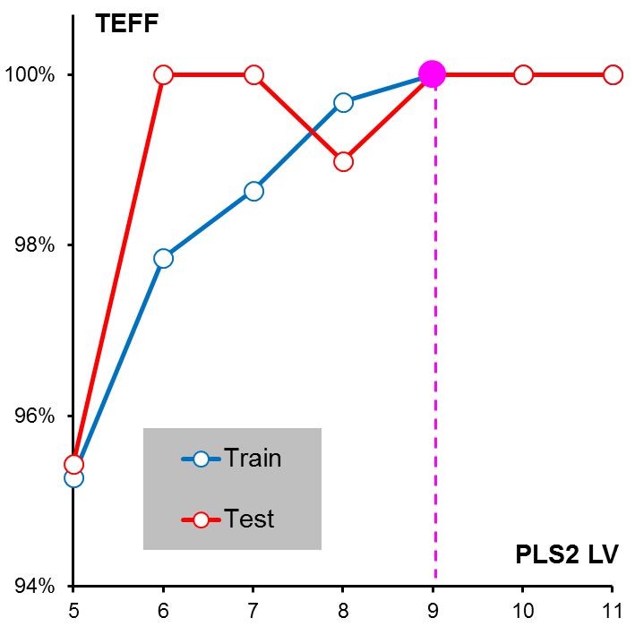
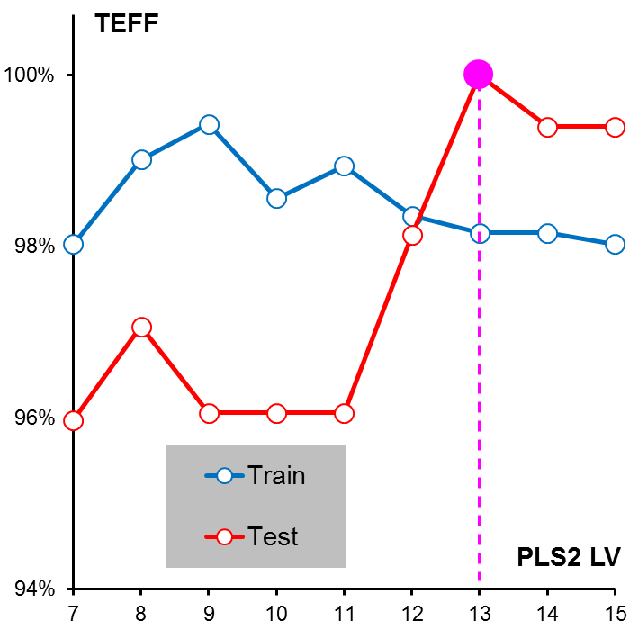
PLS-DA complexity: Olives
Hard
Soft

Slide 28
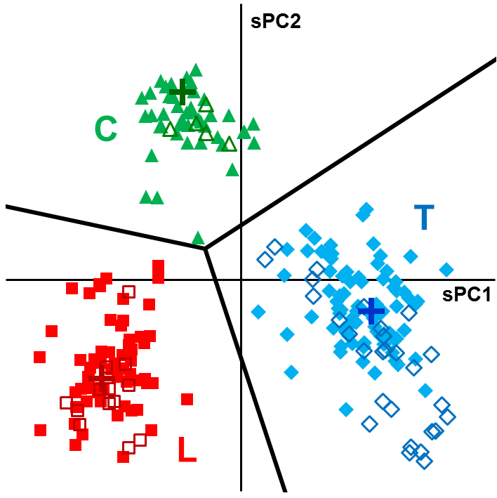
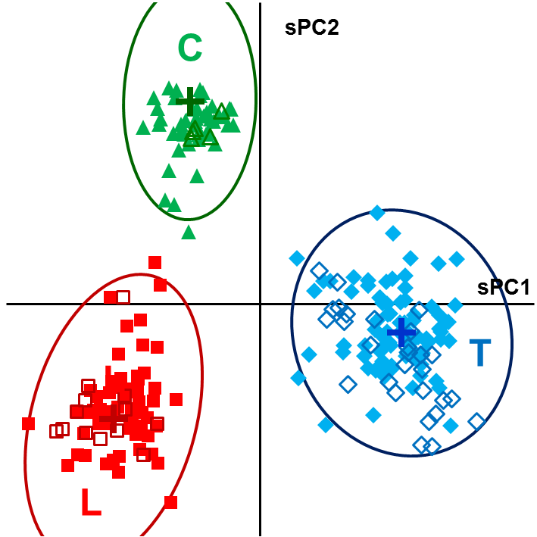
Results: Olives
Hard 9 LVs
Soft 13 LVs
 |  | T | L | C
Training | Sensitivity | 100% | 100% | 100%
 | Specificity | 100% | 100% | 100%
Test | Sensitivity | 100% | 100% | 100%
 | Specificity | 100% | 100% | 100%
 |  | T | L | C
Training | Sensitivity | 96% | 95% | 98%
 | Specificity | 100% | 100% | 100%
Test | Sensitivity | 100% | 100% | 100%
 | Specificity | 100% | 100% | 100%

Slide 29
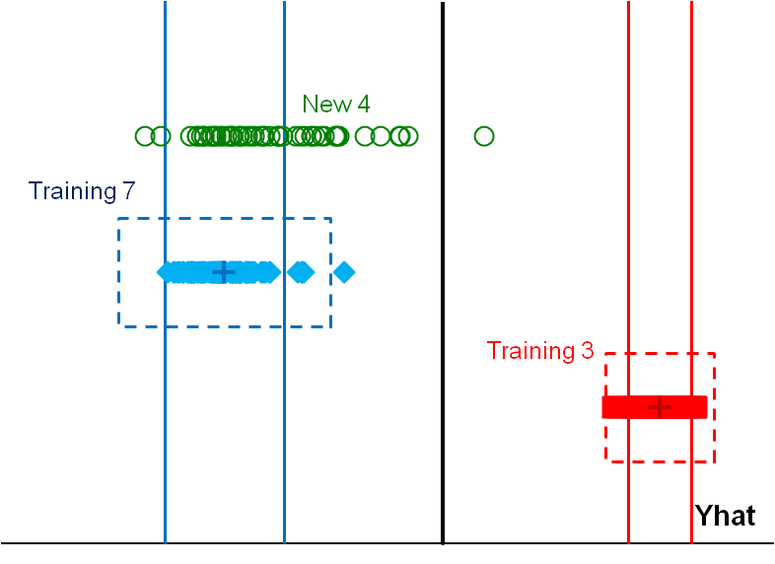
Binary (two class) PLS-DA
y
3, 7 training classes
4 new class
Y
1 | 0
… | …
1 | 0
0 | 1
… | …
0 | 1
+1
…
+1
−1
…
−1
soft acceptance areas
PLS2
PLS
hard acceptance
outliers borders

Slide 30
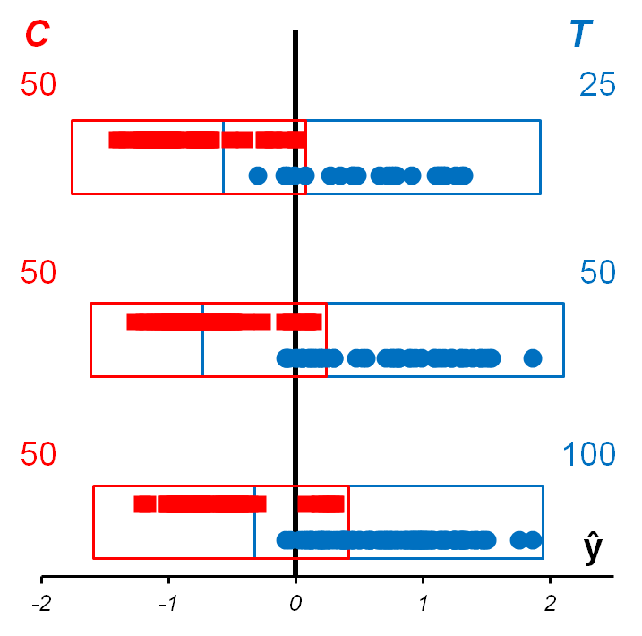
Need for balance? Not at all! Olives case
TEFF
Hard | Soft
92% | 86%
91% | 81%
91% | 89%
TEFF
Hard | Soft
92% | 92%
91% | 75%
91% | 91%
PLS-DA utilizes a regression approach, the efficiency of which mostly depends on the design of experiment, rather than on the size of the data.

Slide 31
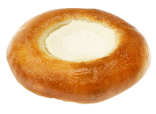
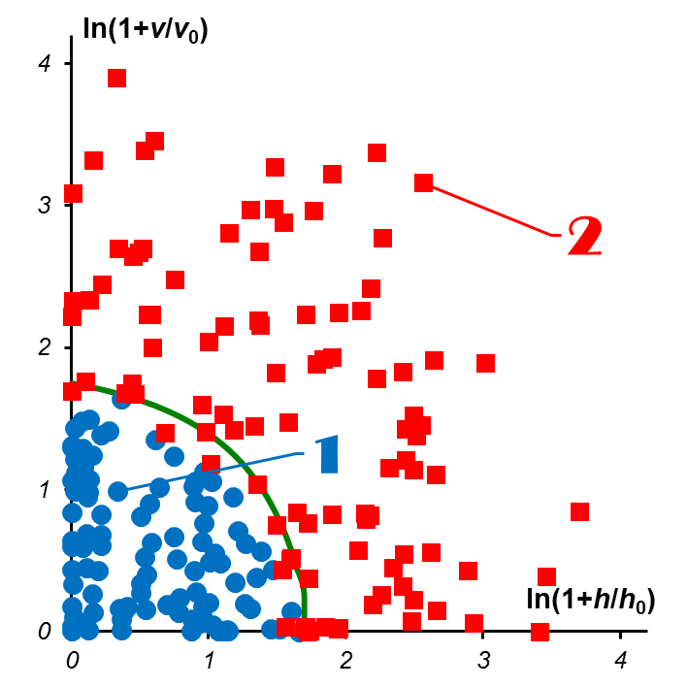
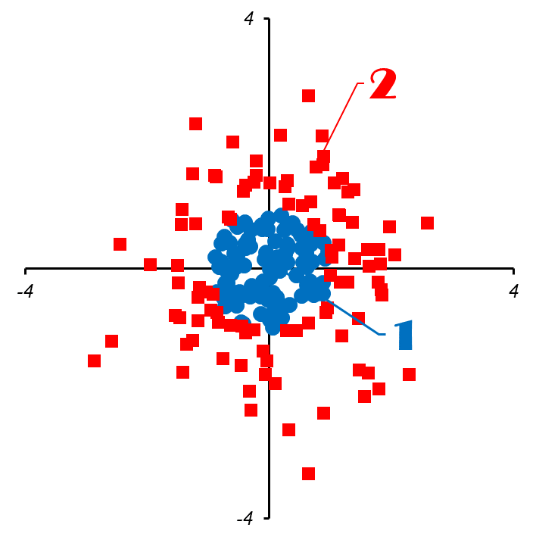
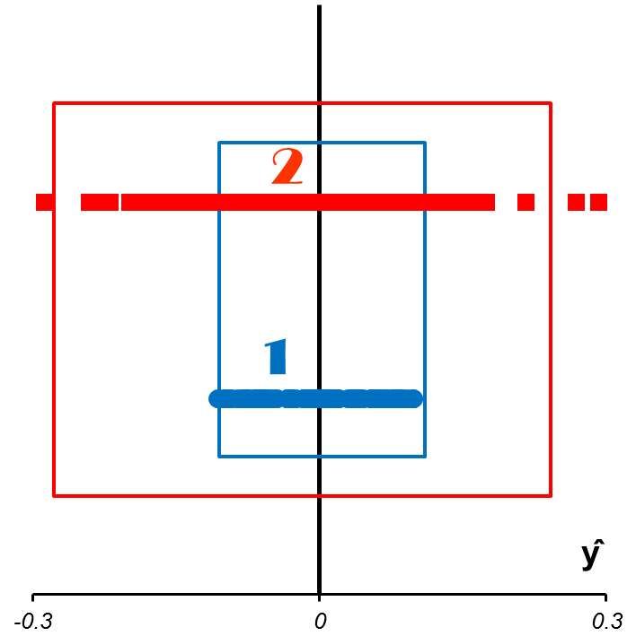
PLS-DA and SIMCA: 'vatrushka’ case
SIMCA
Data set
PLS-DA
TEFF=84 % TEFF= 53/52 %

Slide 32
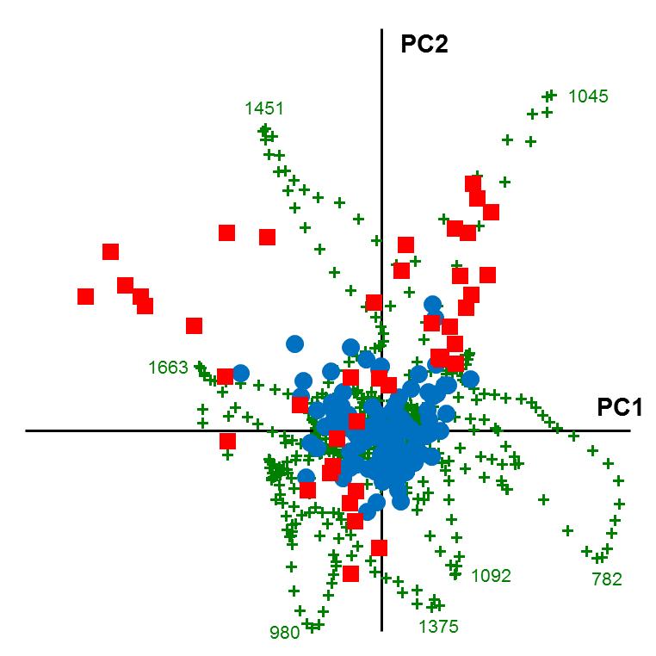
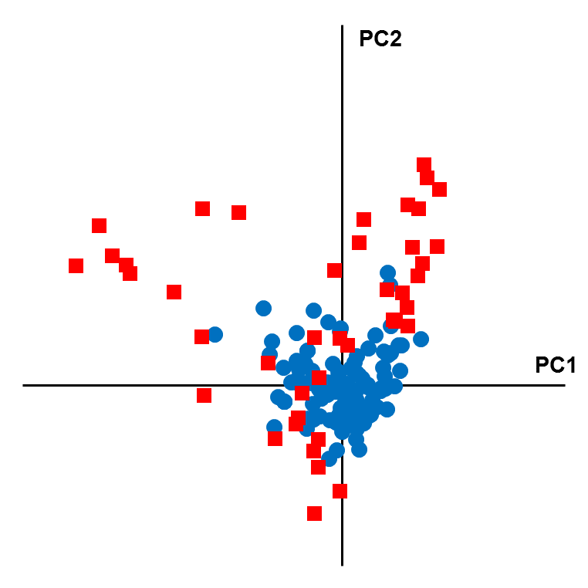
Poster P23
Confocal Raman spectroscopy and multivariate data analysis in evaluation of spermatozoa with normal and abnormal morphology

Slide 33
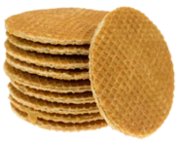
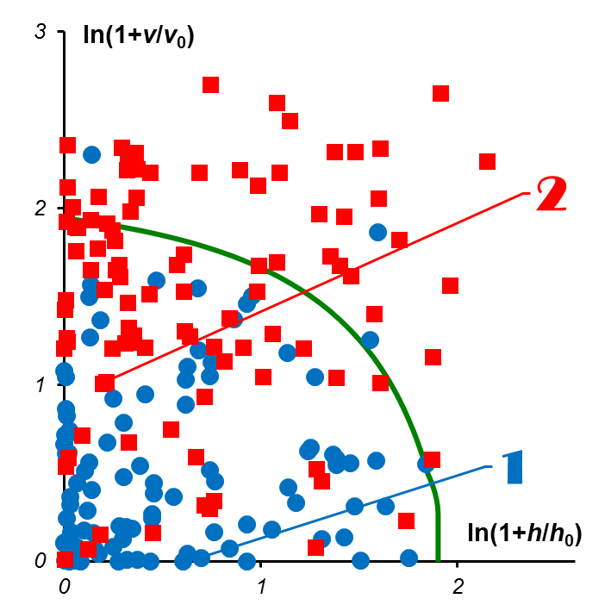
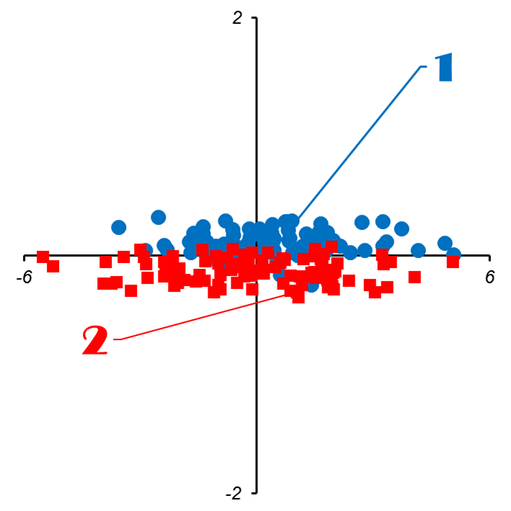
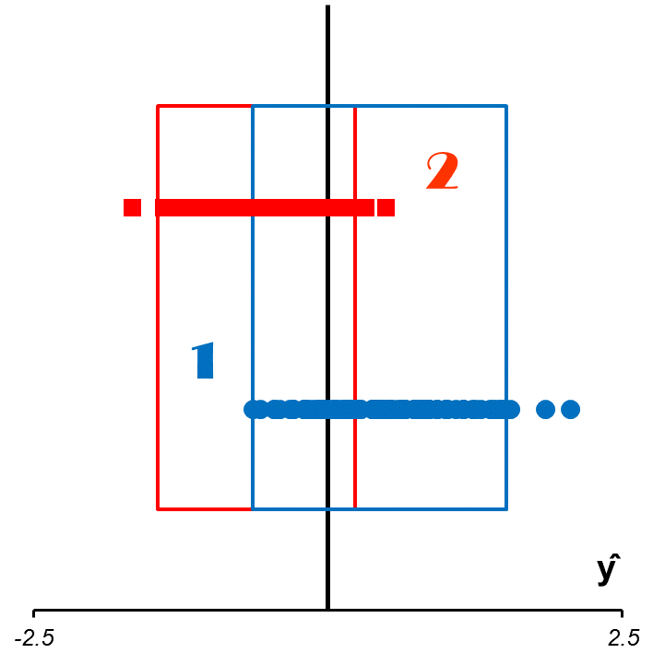
PLS-DA and SIMCA: 'stroopwafel' case
SIMCA
Data set
PLS-DA
TEFF=65 % TEFF= 84/72 %

Slide 34
‘One vs All’ or ‘All vs All’
genuine
fakes
suspect
A1
A2
A3
A4
A5
A6
A7
A3
A2
One vs All
two-class
A6
training
A1
prediction
A7
A4
A5
A1
A6
A2
prediction
A7
All vs All
multi-class
training
A5
A3
A4

Slide 35
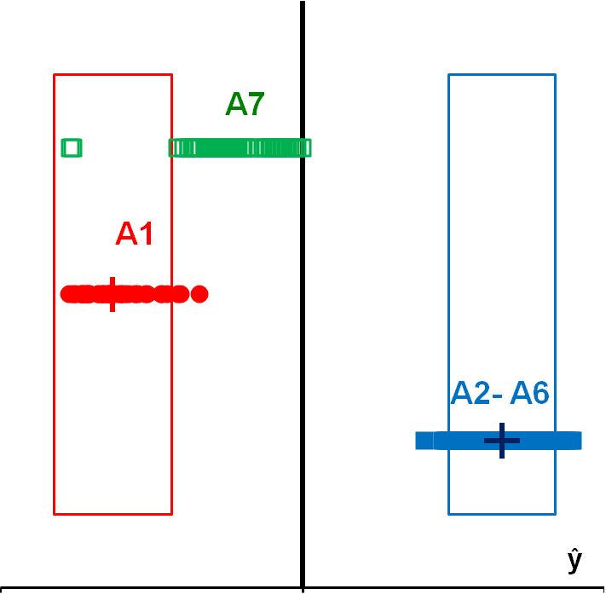
Results: Drugs
 | Training |  | A7
 | TSNS | TSPS | TSPS
One vs All | 94% | 100% | 98%
All vs All | 99% | 100% | 100%
SIMCA | 100% | 100% | 100%

Slide 36
PLS-DA Template for Excel

Slide 37
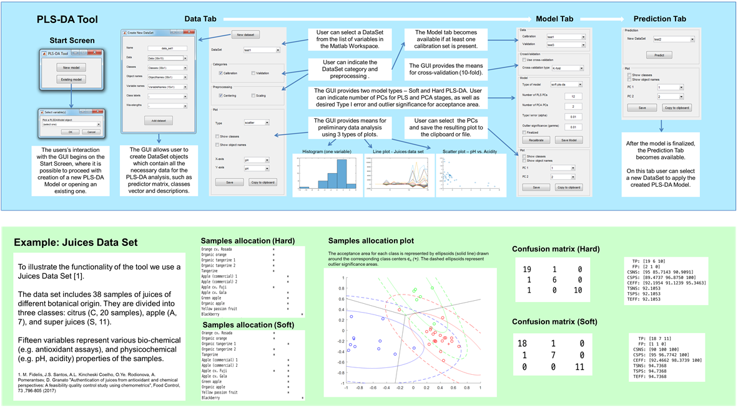
Matlab: see Poster P03
Software implementation of the Hard and Soft Partial Least Squares Discriminant Analysis
Y.V. Zontov, O.Ye. Rodionova, S.V. Kucheryavskiy, A.L.Pomerantsev

Slide 38
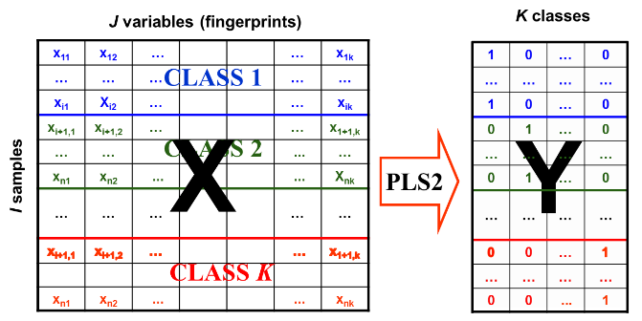
Conclusions 1 of 6
We proposed the multi-class version of PLS-DA, which, in fact, is not more complex than the conventional binary (two-class) PLS-DA.
The method does not utilize the PLS scores, but is entirely based on the predicted dummy responses.

Slide 39

Conclusions 2 of 6
We suggested using PCA that converts response matrix Ŷ, into the super score matrix T.
We discussed an amusing geometry of the score space.

Slide 40
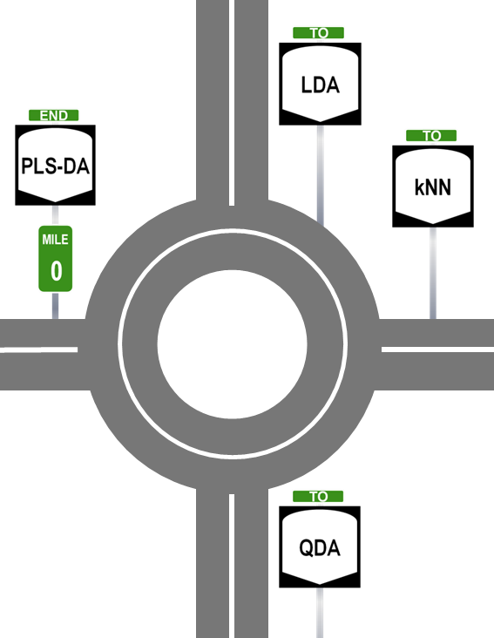
Conclusions 3 of 6
We consider that PLS-DA is not a classifier. It serves as a feature extractor from high-dimensional X space into low-dimensional Y space.
Classification methods come after.

Slide 41
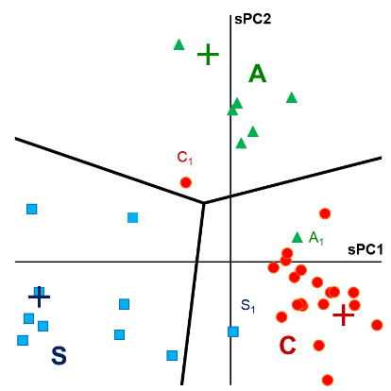
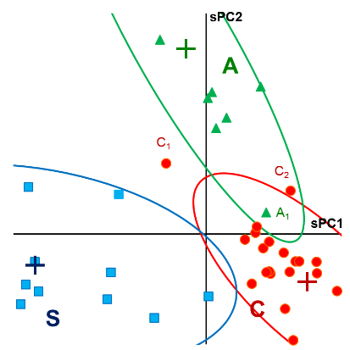
Conclusions 4 of 6
We introduced two classification methods that utilize that concept.
The first is a conventional hard PLS-DA approach based on LDA.
The second is a novel soft PLS-DA method based on QDA.

Slide 42
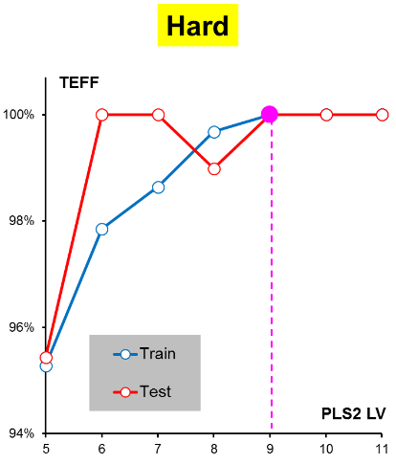
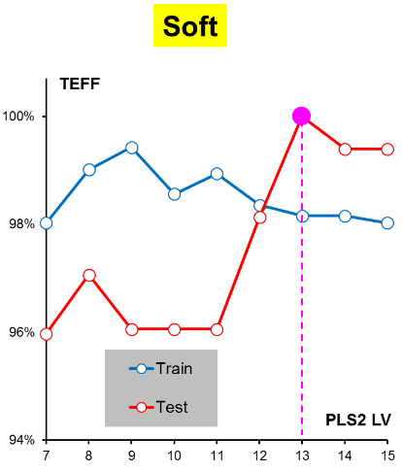
Conclusions 5 of 6
We defined the principal measures of classification quality (sensitivity, specificity, and efficiency) for the multi-class PLS-DA.
We suggested using these characteristics for the selection of the PLS model complexity.

Slide 43
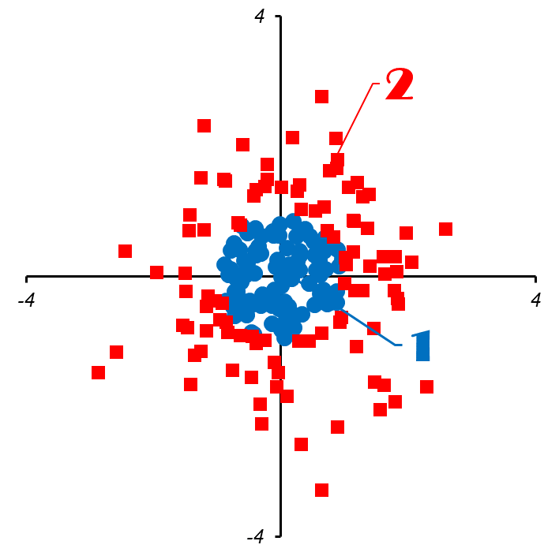
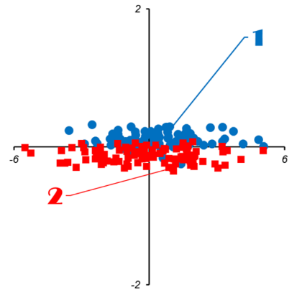
Conclusions 6 of 6
We compared the discriminant (PLS-DA) and the class-modeling (SIMCA).
It was shown that SIMCA is better when one class is tight, and the other class is broad.
On the contrary, PLS-DA is preferable in cases when two classes have the same major components but different impurities.

Slide 44
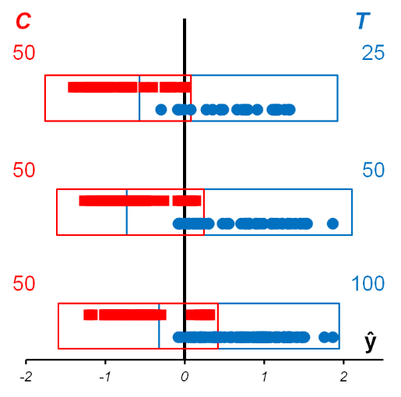
Conclusions 7 of 6
A popular opinion that an equal number of objects in the training classes is preferred for a good PLS-DA model is analyzed and found to be wrong.
In fact, PLS-DA utilizes a regression approach, the efficiency of which depends primarily on the design of the experiment, rather than on the size of data.

Slide 45

Thank you for
your attention
A Lawyer’s failure

Slide 46
END
TO
TO
TO
PLS-DA
LDA
QDA
kNN
MILE
0

